Slide 1
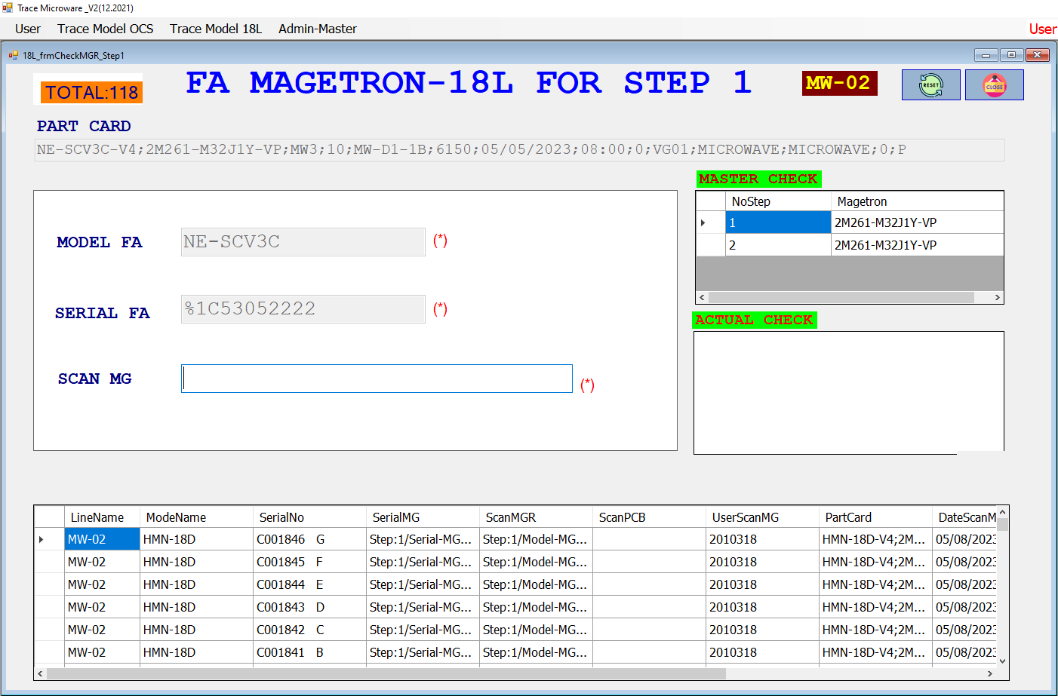
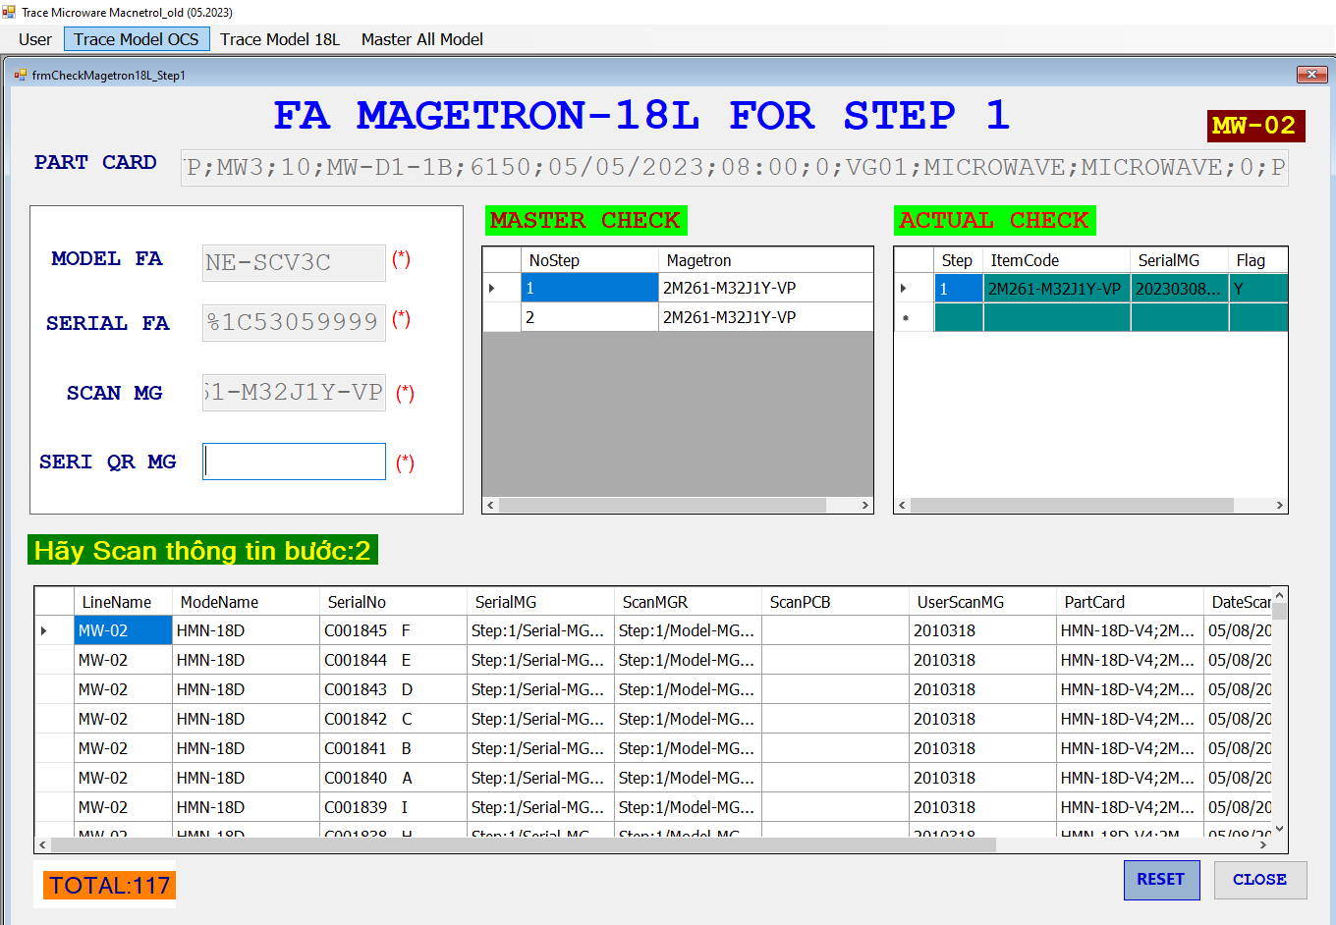
Trace Microwave Magnetron for SCV Model
1/2
Add new function check trace for magnetron QR code for model SCV of category Microwave.
Developer: Develop team
Apply: May.2023
Expn: 0
Quality & Save Cost
◆Before
◆ After
Remain 4,300pcs
Old Parts
In stock
Not scan serial QR code magnetron
Add more New serial QR code magnetron
Manual save traceability data magnetron by excel
=> Easy mistake, not control quality and history trace.
Take long time for operation of user.
Take time: 4,300pcs ~ 30’/1pcs ~ 2,150h
Reduce operation time and easily save traceability functions checker history.
No mistake, easy control & traceability on the system
Save time: 2,150h Save cost: 4,300 USD.

Slide 2




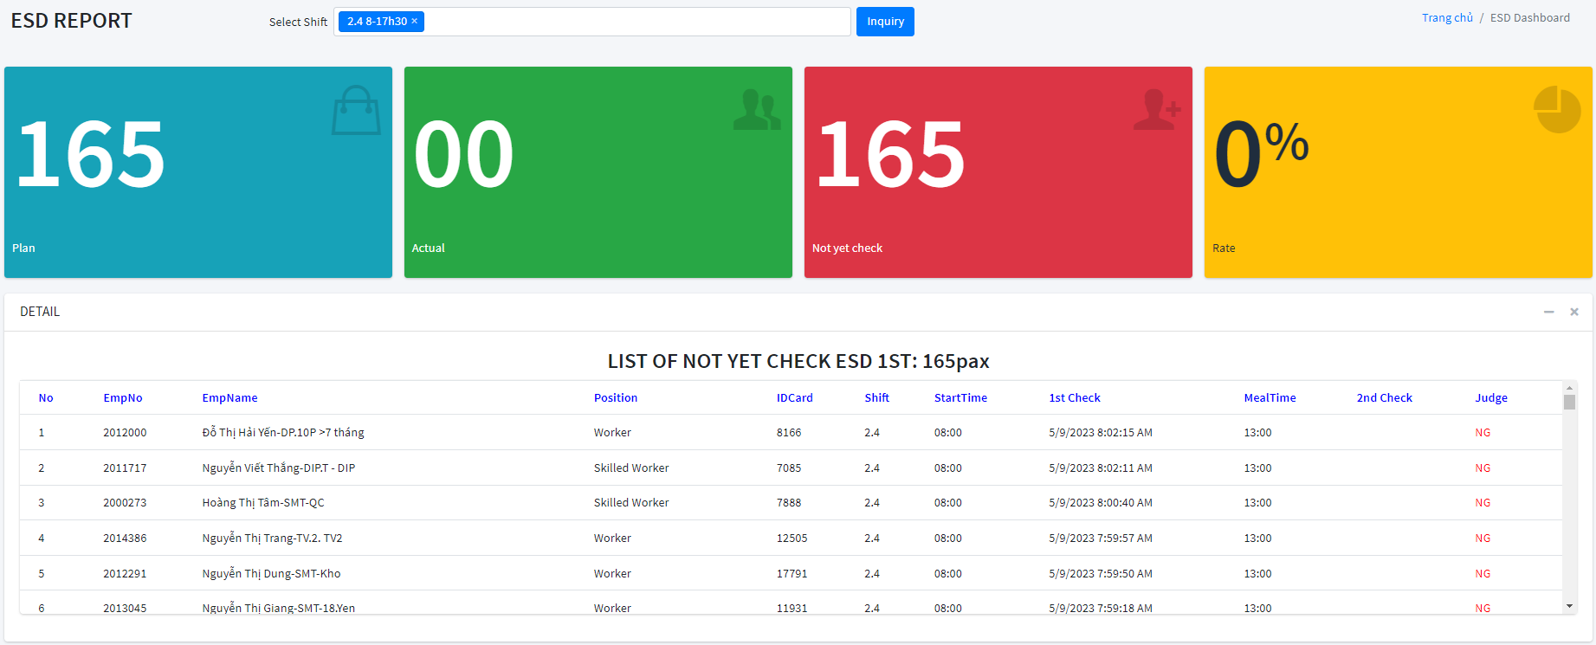
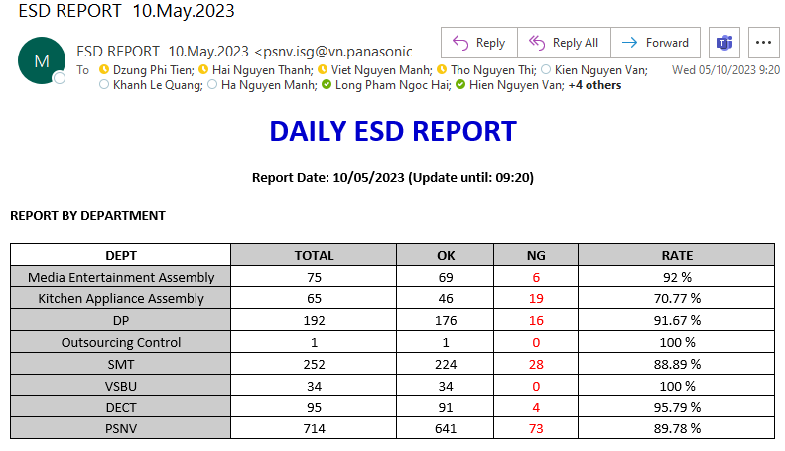
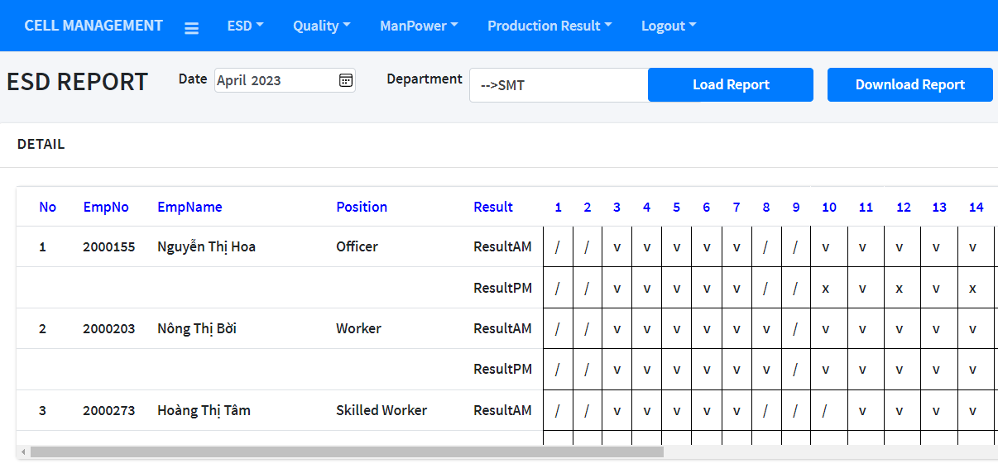
ESD SYSTEM
2/2
Auto collect data, warning, auto daily report, electronic ISO form
Developer: Develop Team
Apply: Mar.2020
Expn: 0
Save cost & time
◆Before
◆ After
ESD Operation
Auto
ESD Station
SERVER
Board
ESD Station
Pls check
1.May
2.May
3.May
Pls check
v
v
v
AM
v
v
v
PM
Check ESD
Check ESD
Tick to checksheet
(Paper)
Visualize
Auto Report
E-ISO form
HR of sections collect checksheet, check, make report
Take time: 120,000min/y (8min/PIC/m~1250 PIC)
Lost paper: 36RAM/y (~3RAM/m)
Lost cost: ~3,450 $/y (manpower + paper)
Save time: 120,000min/y
Employees no need to tick to checksheet & print paper
Save cost: 3,450 $/y.

